Slide 1
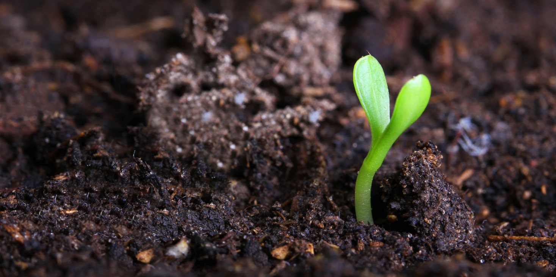
Developing Environmental Vocabularies
Summer Internship 15/16
Xavier Butcher | Vacation Student
29 January 2016
Environmental informatics/land & water

Slide 2
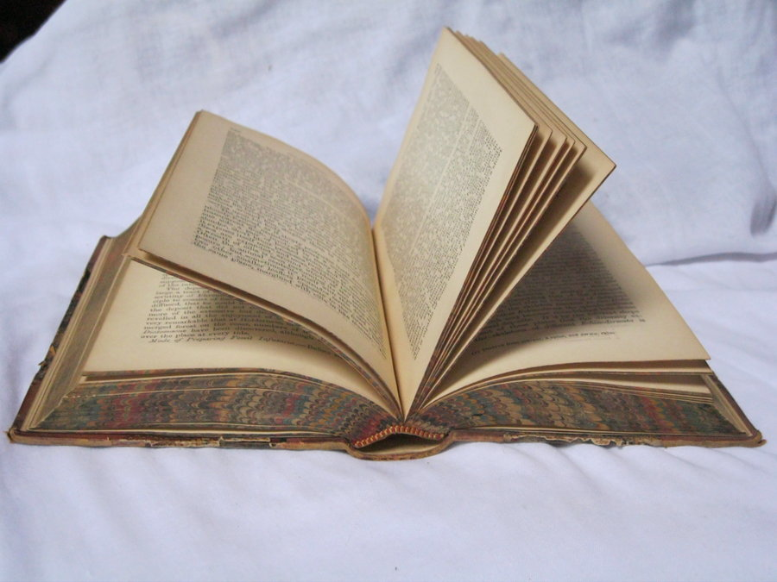
Contents Page
Biography
Introduction
Example
Materials
Method
Results
Discussion
Conclusion

Slide 3
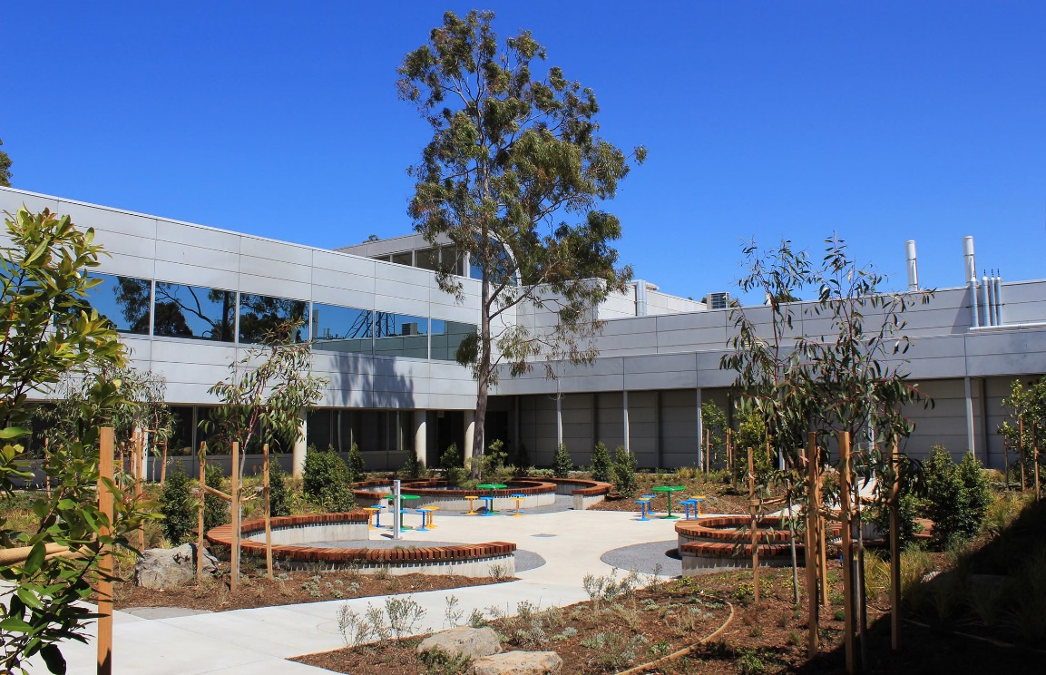
Biography
About me
Why I wanted to spend my summer at CSIRO
Notes:
About Me:
Xavier Butcher
21 years old
Going into 4th year this year
Bachelor of Applied Science (Surveying) (Honours) at RMIT
Why I wanted to spend my summer here at CSIRO:
Gain experience in a renowned scientific research organisation
Previous work experience include BOM and GA
Broaden my horizons into different areas of study
Mandatory 3 month work experience quota
Full time pay is nice

Slide 4
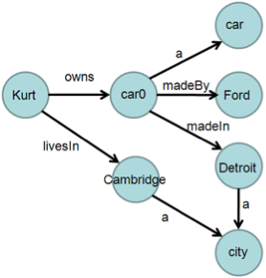
Introduction
Aim & Tasks
What is a vocabulary and why are they important?
SKOS
Semantics
RDF
SPARQL
Notes:
Aim & Tasks
The aim for this project was to create and collate a number of online vocabularies into a standard format and location
There were 4 main tasks relating to this project, which were completed successfully:
Source relevant existing vocabularies
Convert the vocabulary content using semantic web technologies (RDF/SKOS)
Harmonising vocabulary content with existing vocabularies where applicable
Publish vocabularies to SPARQL triple stores where applicable
What & Why
Vocabularies are often hosted online, and are used to support environmental applications. They contain labels, definitions and other related information for a particular concept or registry. This project mostly focussed on land and soil operations. Currently, a number of vocabularies are unique to their individual application, and are often in different formats (text, csv, pdf, or lists). Having a definitive vocabulary on a subject is critical, as the same term could have different definitions or meanings in different vocabularies.
Technical Stuff
These vocabularies follow the guidelines of SKOS, the Simple Knowledge Organization System, which is an industry standard of rules and guidelines across online vocabularies which aims to make publication and use of vocabularies an easy and standard process.
It is also necessary to introduce semantic relationships, which essentially add another layer of detail to vocabulary. This means different terms can be placed in a hierarchical order (broader and narrower), as well as relating similar terms.
RDF is the Resource Description Framework. This is the data model that these vocabularies use. It relies on statements that have a subject-predicate-object (eg “The Sky” “has” “the colour blue”).
SPARQL the SPARQL Protocol and RDF Query Language is, as the acronym suggests, an RDF query language. It is tending to be the industry standard query language. SPARQL allows the user to query semantic data in databases, and retrieve and manipulate RDF data.

Slide 5
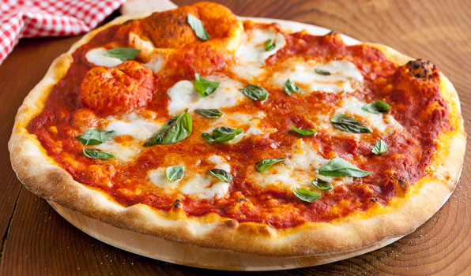
Basic Example
Pizza SKOS
Concept of Margherita Pizza
Label, URI and definition
Hierarchy
Related
Collection
Notes:
This example will centre on the ‘Concept’ of a “Margherita Pizza”. As a bare minimum, a Concept must have a Label (Margherita Pizza), a URI (Unique Resource Identifier – a unique web address where the concept can be located) and a Definition (Margherita Pizza is a flatbread generally topped with tomato sauce and cheese and baked in an oven). A Concept may also be part of a hierarchy of other Concepts. In this case, “Margherita Pizza” is a Narrower Concept of “Pizza”, which itself is a Narrower Concept of “Food”. A Concept can also be related to other concepts regardless of hierarchy, for instance “Margherita Pizza” is related to “Mushroom Pizza” in the sense that they are both pizzas that have cheese and sauce. A Concept can also be part of a collection. For example “Margherita Pizza” can belong to the “Vegetarian Pizza” collection.

Slide 6
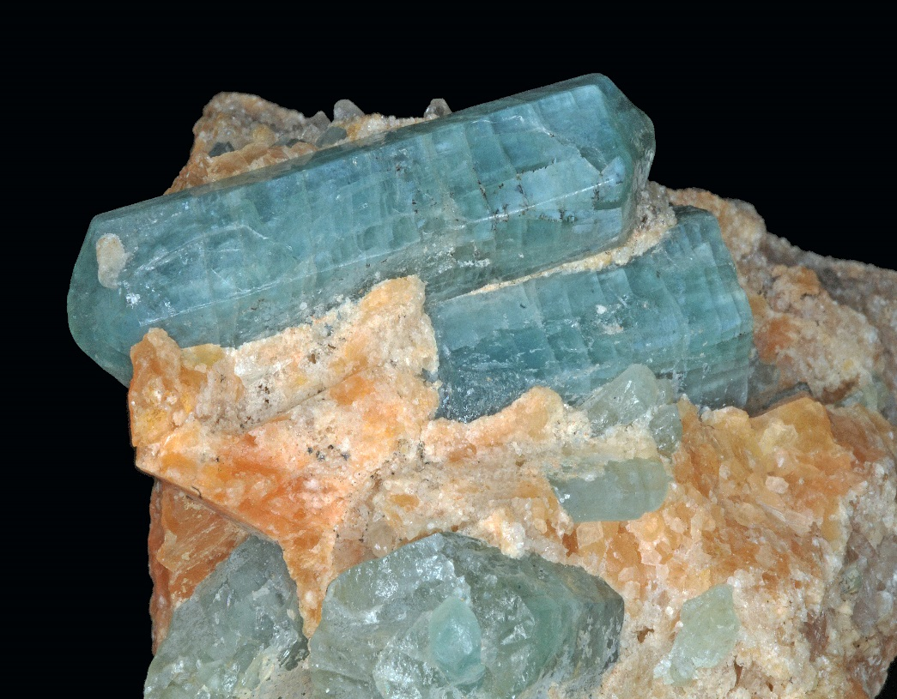
Materials
Australian Soil and Land Survey Handbook (Yellow Book)
Soil Information Transfer and Evaluation System (White Book)
Environmental Informatics Wiki’s
Linked Data Registry (LDR)
Microsoft Office
Notepad++
TopBraid Composer
RDF123
Microsoft SQL Server Management Studio
Notes:
Refer to my report for full references.

Slide 7
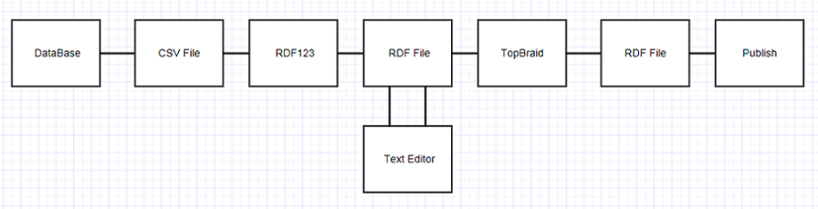
Flowchart

Slide 8
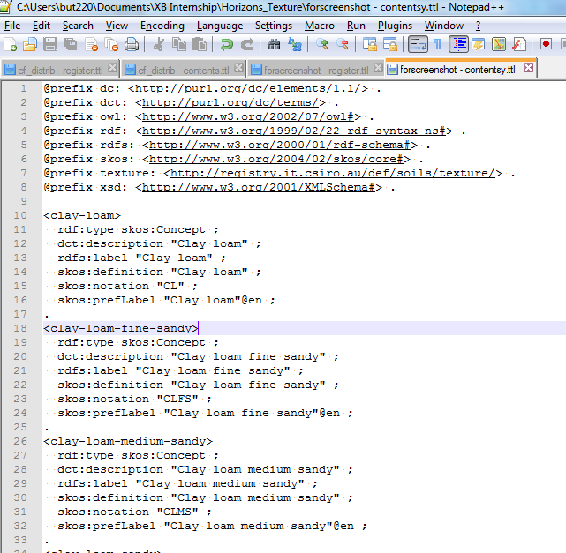
Method
Pre-Reading (articles, journals and wikis)
Microsoft SQL Database (natsoil)
Microsoft Excel (CSV)
RDF123 (RDF editor)
notepad++ (Text editor)
TopBraid (Semantic web modelling)
notepad++ (Post processing)
Publishing (LDR)

Slide 9
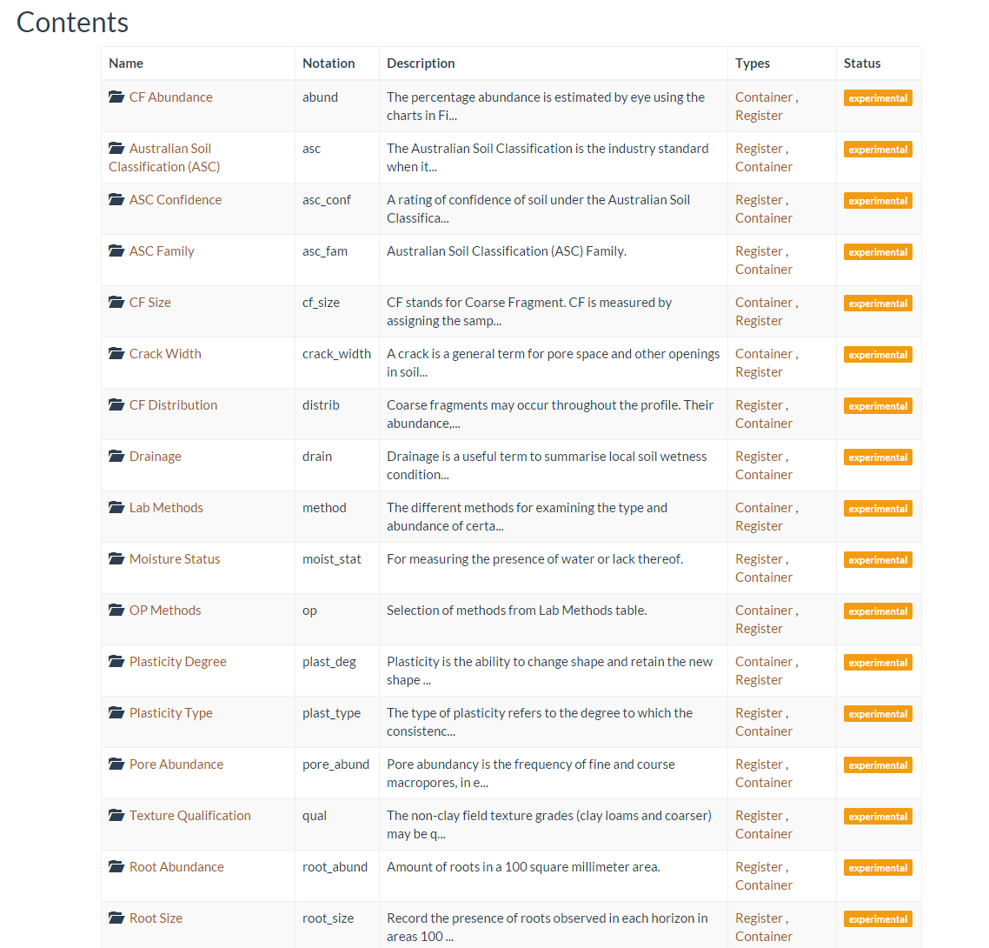
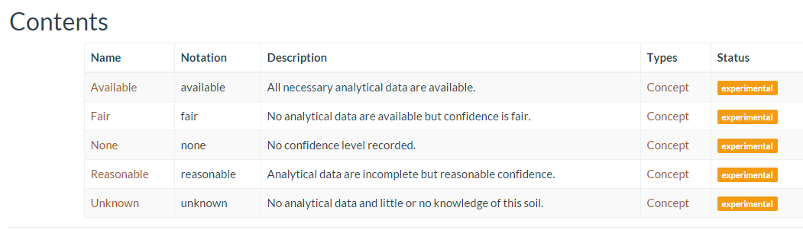
Results
Notes:
All up I have published 26 soil related vocabularies and counting.
The top image shows a few of them. They are stored as registers or containers. Each one of those registers contains a set of concepts, which can be seen in the bottom image.
These vocabularies are up on the CSIRO registry and can be accessed by anyone. So if you ever need to look up the confidence levels of the Australian Soil Classification, you’ll know where to find it!

Slide 10
Discussion
Specific vocabulary information
Recurring errors
Full automation
Future developments
Presenting to colleagues in Canberra

Slide 11
Conclusion & Acknowledgements
What I’ve learnt regarding the specific project
What I’ve learnt from the overall internship experience
Thanks to:
Jonathan Yu
Simon Cox
Bruce Simons
Luis Neumann

Slide 12
Thank you – Questions?
Land & Water/Environmental Informatics Vacation Student
xavier.butcher@csiro.au
Environmental Informatics/Land & Water

